Slide 1
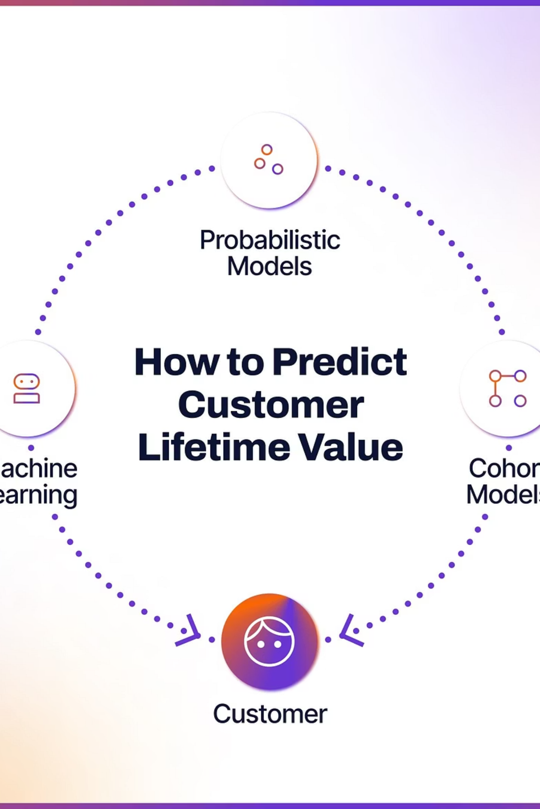
Predicting Customer Lifetime Value (CLV)
Unlocking Future Growth for E-commerce Success

Slide 2
Project Overview: Forecasting Customer Value
Our objective is to accurately predict Customer Lifetime Value (CLV) for Amazon customers, providing crucial insights to refine business strategies.
Goal
Significance
Technologies
Predict future customer profitability to optimize business decisions.
Empower targeted marketing, enhance customer retention, and identify high-value segments.
Python, pandas, scikit-learn, Flask, joblib, HTML/CSS.

Slide 3

Data Understanding & Cleaning: The Foundation of Prediction
Raw data is transformed into a robust dataset through meticulous cleaning and preprocessing, ensuring accuracy for CLV predictions.
Data Collection
Clean & Impute
Remove Duplicates
Standardize & Create Features
Raw Data Inclusions: Customer purchases, age, payment methods, ratings, purchase dates.
Cleaning Steps: Filling missing values (median/mode), dropping duplicates, standardizing formats (date parsing, gender normalization), clipping outliers.
Feature Creation: Loyalty Score, Customer Segment, Preferred Shopping Channel, Discount Applied, Return Status.
Encoding: One-hot encoding for all categorical variables.

Slide 4
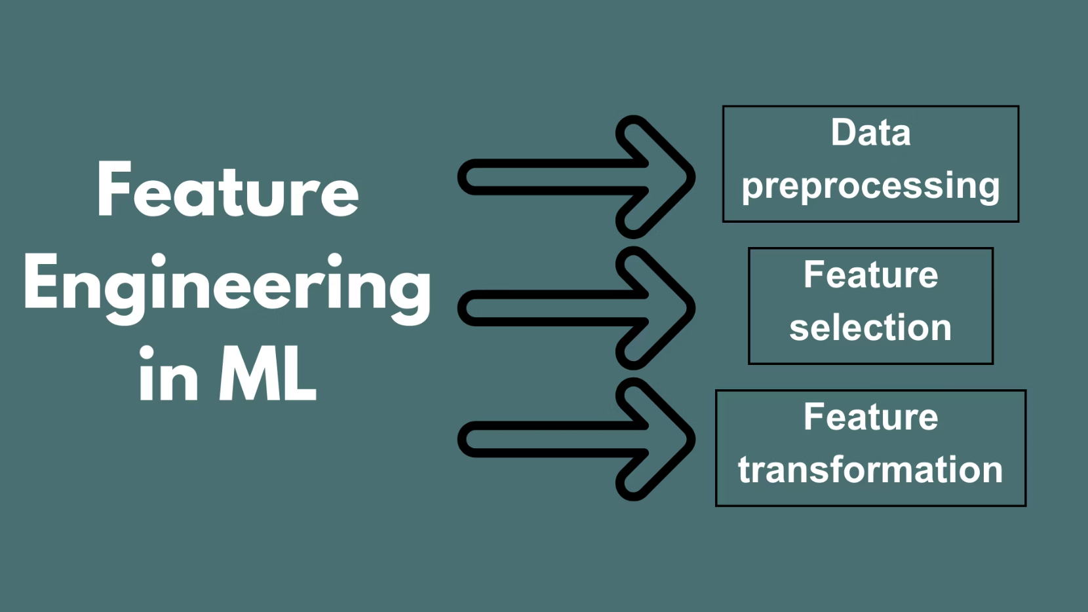
Feature Engineering: Unlocking Predictive Power
Carefully selected and engineered features are crucial for building an accurate CLV prediction model. Each feature contributes uniquely to understanding customer behavior.
Age: Demographic factor influencing purchasing habits.
Purchase Amount: Direct indicator of customer spending.
Loyalty Score: Calculated from purchase frequency and total spent, reflecting customer dedication.
Discount Applied: Reveals price sensitivity and promotional impact.
Payment Method: Can indicate customer preference and financial behavior.
Customer Segment: Categorizes customers (New, Regular, VIP) based on engagement.
Preferred Shopping Channel: Online vs. Offline purchasing habits.

Slide 5
Model Building: Crafting the Prediction Engine
A supervised regression approach is employed to predict a numeric CLV, using a robust pipeline for data transformation and model training.
1
Approach
Supervised regression for numeric CLV prediction, chosen for its ability to forecast continuous values.
2
Pipeline
ColumnTransformer scales numeric features and one-hot encodes categorical data.
3
Model
Linear Regression for its interpretability and effectiveness in predicting CLV.
4
Data Split
80% training, 20% testing to evaluate model performance.
5
Metrics
R² Score for explained variance, RMSE for prediction error.
6
Persistence
Model pipeline and features saved with joblib for web app deployment.

Slide 6
Web Application: Bringing Predic
tion to Life
The Flask-based web application provides an intuitive interface for users to obtain real-time CLV predictions.
Backend Workflow (Flask)
Frontend Highlights (HTML/CSS)
Loads pre-trained model pipeline and features.
User-friendly form with clear input fields (Age, Purchase Amount, Loyalty, etc.).
Collects user input from the HTML form.
Applies necessary preprocessing to input data.
Stylized design with dropdowns for categorical inputs.
Generates CLV prediction.
Dynamic output display after form submission.
Displays predicted CLV in Rupees (₹) to the user.
Clean, minimalist aesthetic for ease of use.

Slide 7

Demo & User Flow: Experiencing the Prediction
Navigate the straightforward process of getting a CLV estimate from the web application.
1. Landing Page
3. Submission
User visits the main web application page.
User submits the form to trigger the prediction.
1
2
3
4
2. Input Form
4. CLV Estimate
User fills in details like Age, Purchase Amount, Loyalty Score, etc.
Backend processes data and displays the predicted CLV.

Slide 8
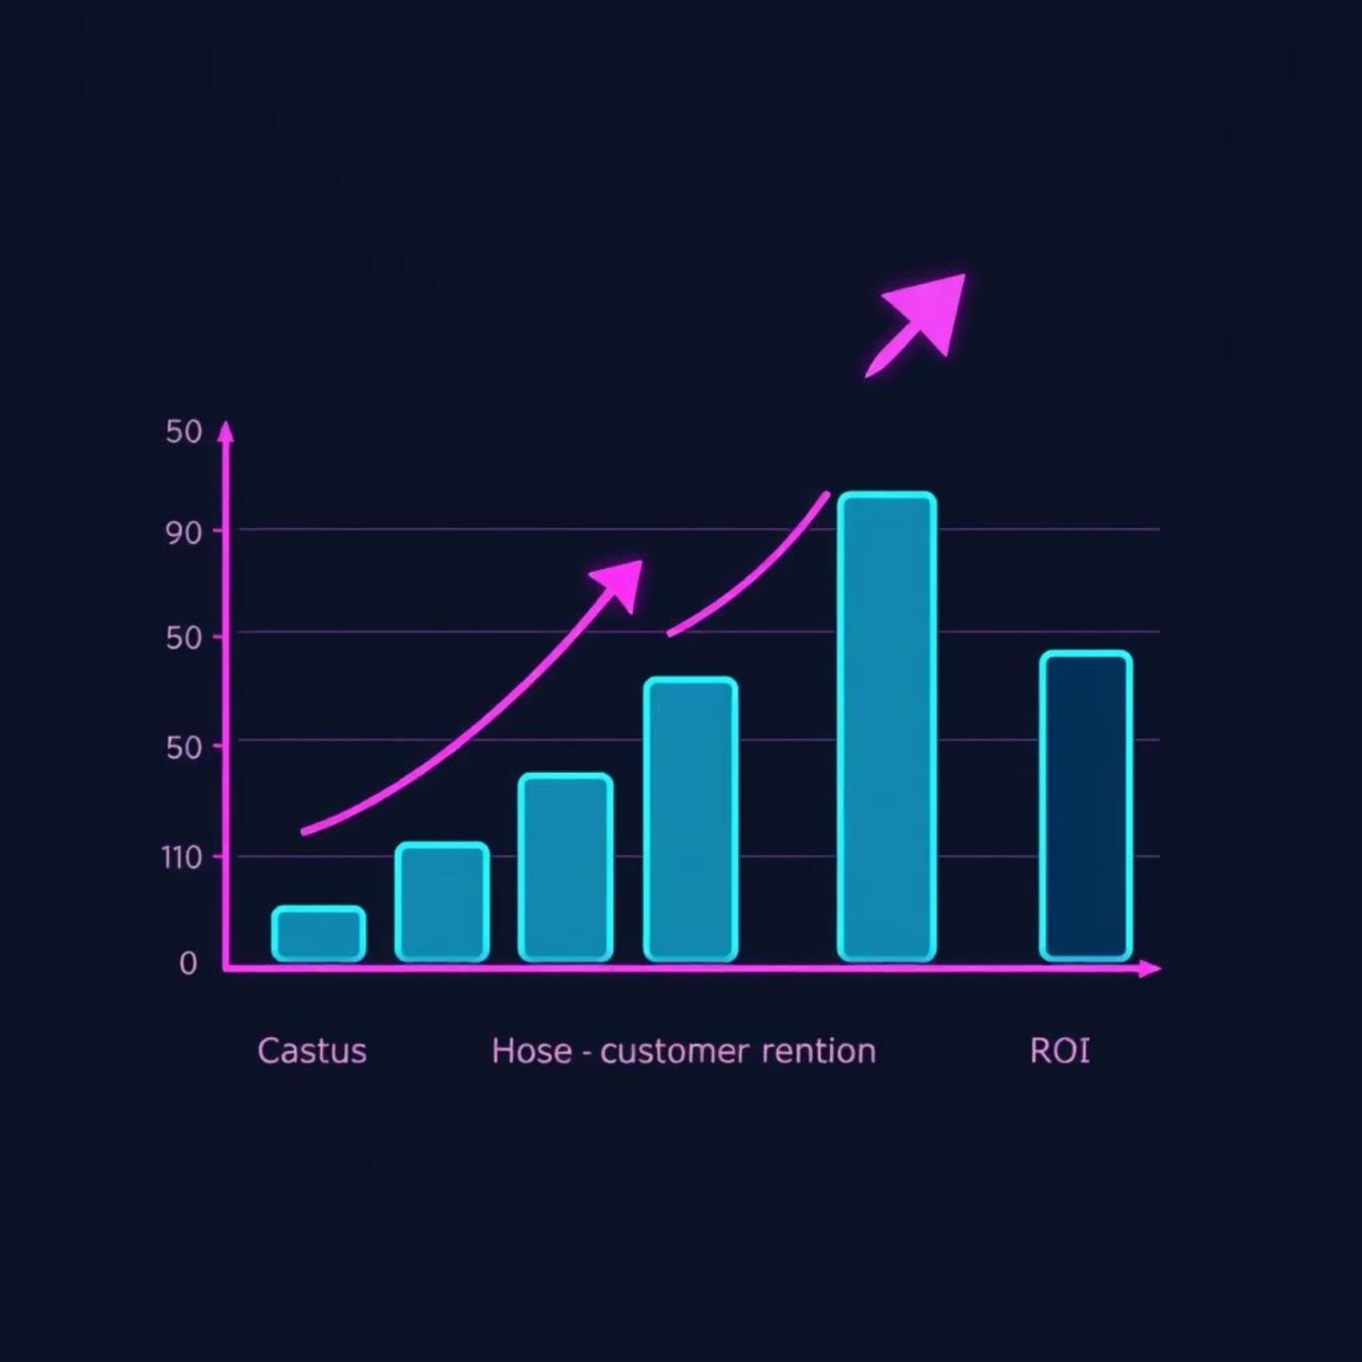
Results & Impact: Driving Business Decisions
Our CLV prediction model demonstrates strong performance, offering tangible benefits for strategic business initiatives.
Model Performance
R² Score: 0.85 (sample value indicating high variance explained).
RMSE: ₹500 (sample value showing average prediction error).
Business Utility
Identify High-Value Customers: Pinpoint and nurture your most profitable customers.
Targeted Marketing: Craft personalized campaigns based on predicted CLV.
Retention Strategies: Develop proactive measures to retain at-risk customers.
Resource Optimization: Allocate resources efficiently for maximum ROI.

Slide 9




Future Enhancements: Expanding Capabilities
We envision several enhancements to further refine the CLV prediction model and expand its real-world utility.
Advanced Models
New Features
Integrate sophisticated algorithms like XGBoost for improved accuracy.
Incorporate additional data points like demographics and product categories.
Cloud Deployment
Real-time Updates
Deploy the application to a cloud platform for public accessibility and scalability.
Implement continuous model retraining for dynamic predictions.

Slide 10

Thank You

